Slide 1
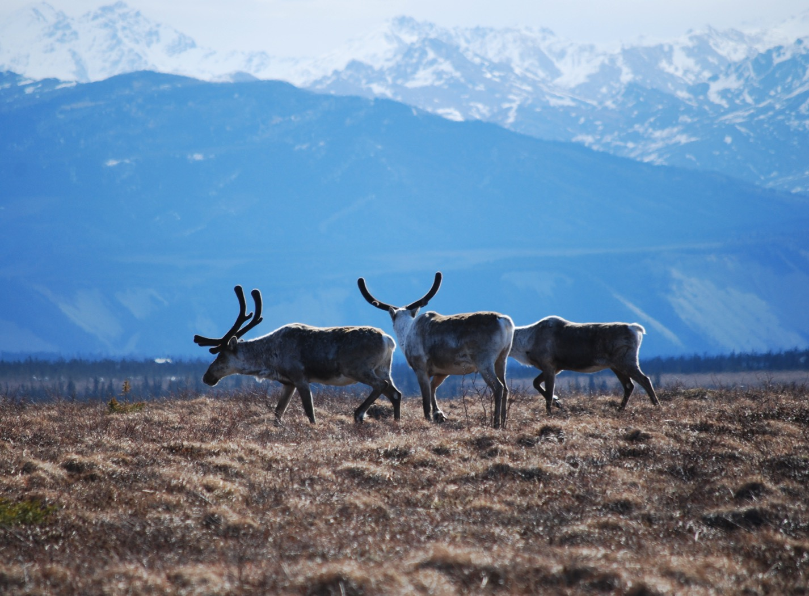
Arctic Boreal Vulnerability Experiment (ABoVE)
2017 ABoVE Airborne Campaign
17 July 2017 (DOY 198)
LVIS: BERMS – BOREAS Area
Charles Miller, Deputy Science Lead
Jet Propulsion Laboratory, California Institute of Technology
and the ABoVE Science Team For Hank Margolis, Eric Kasichke, Bruce Tagg
NASA HQ
2017

Slide 2
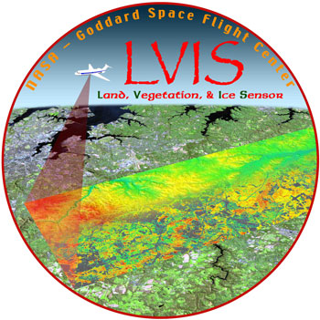
17 July 2017/DOY 198 BERMS – BOREAS Area
Daily Status:
LVIS / Dynamic Aviation B-200T (N44U)
REPORT DATE: 17July 2017
Current Status of Aircraft: GREEN
Current Status of LIDAR: GREEN
Current Status of Camera: GREEN
Current Deployment Location: GGW Montana
Crew: Grindrod, Nathan, Blair, Hofton
Science Coordinator: M Hofton
Science Lead: B Blair

Slide 3
17 July 2017/DOY 198 BERMS – BOREAS Area
Daily Summary:
Departed GGW at 0900
Went to do 3 legacy lines in BERMS region
W-E line flown 3x due to clouds on east side
Offset last repeat
Line 801 goes over BOREAS flux tower and HELCIA sites
Line 129 and 3 other N-S lines
Did not finish lines due to 100 kt headwind
RTB due to low fuel
Tues 7/18 – transit home

Slide 4
17July 2017/DOY 198 72-Hour Look Ahead
All plans weather dependent
Tuesday 18 July 2017 (DOY 199):
Transit GGW – Maryland/Virginia
Deployment complete

Slide 5
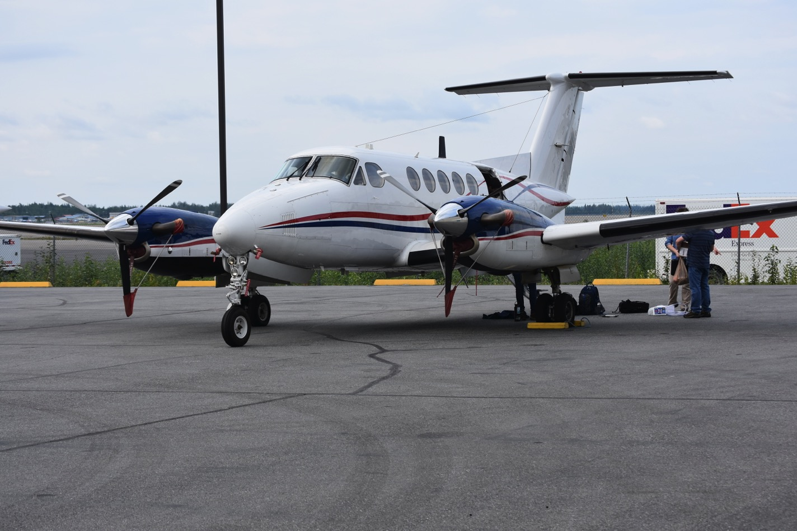
17 July 2017/DOY 198 BERMS – BOREAS Area
N44 “Unicorn” prepares for its journey to Montana

Slide 6
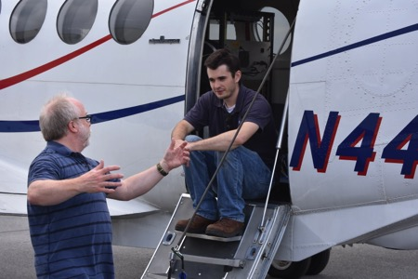
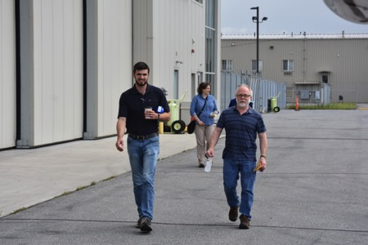
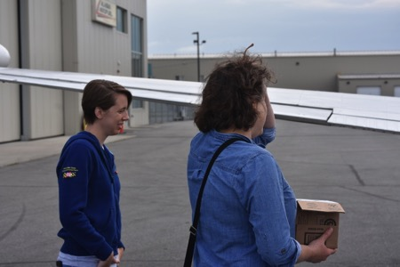
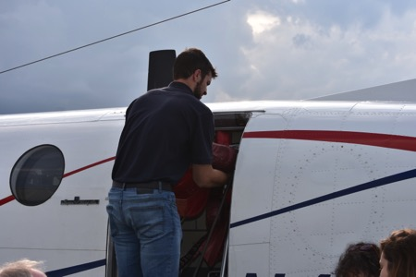
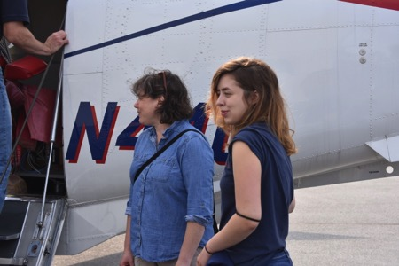
17 July 2017/DOY 198 BERMS – BOREAS Area

Slide 7
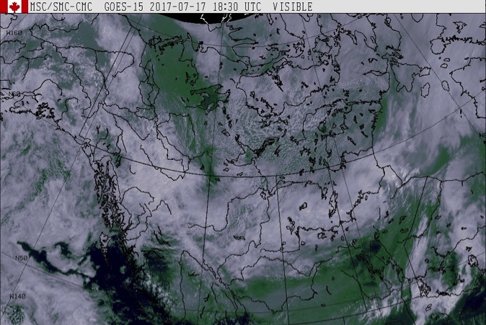
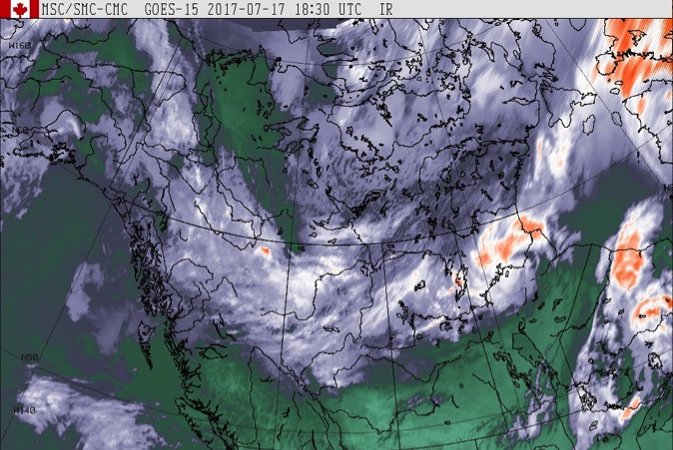
17 July 2017/DOY 198 BERMS – BOREAS Area
GOES West Vis
1830Z
GOES West IR
1830Z
Partly cloudy across southern Saskatchewan and the BERMS/BOREAS area

Slide 8
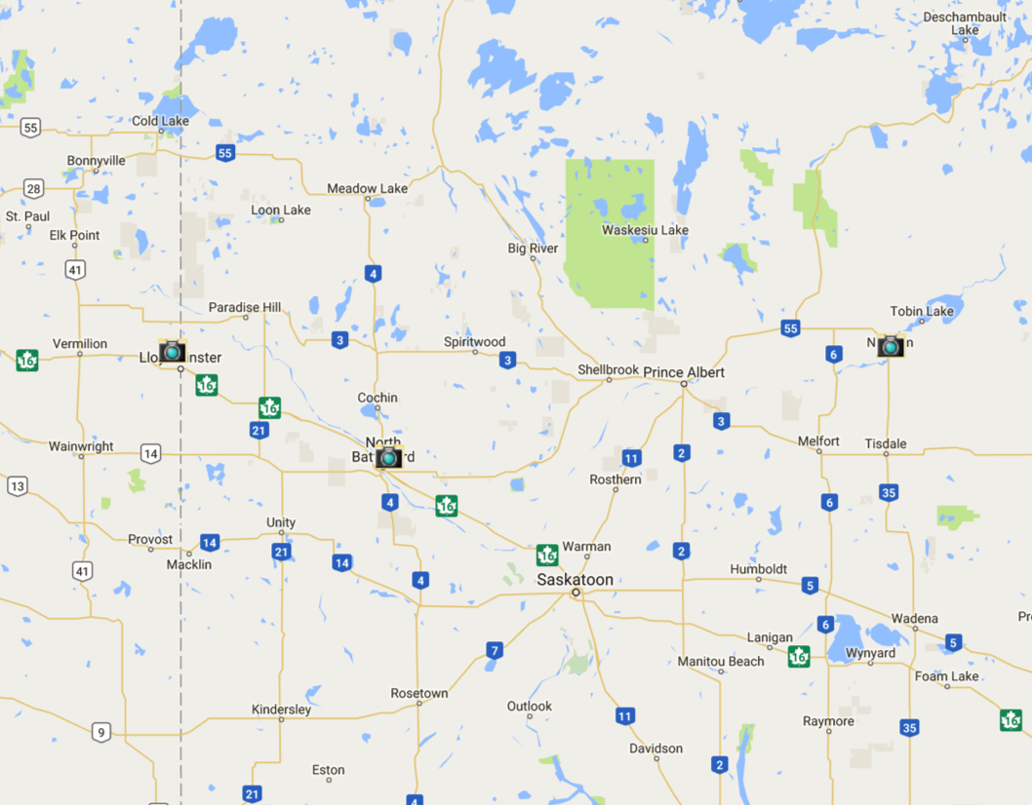
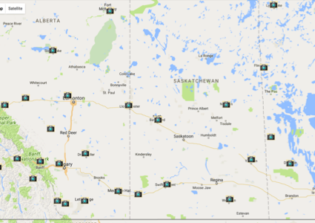
17 July 2017/DOY 198 BERMS – BOREAS Area
BERMS Area Canadian Aviation Webcameras
Notes:
See http://www.metcam.navcanada.ca/hb/index.jsp?lang=e

Slide 9
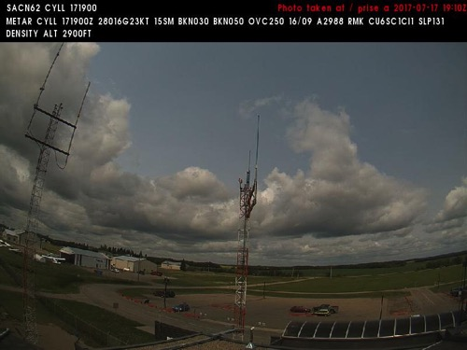
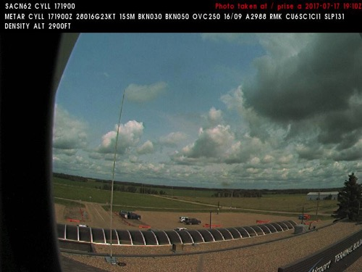
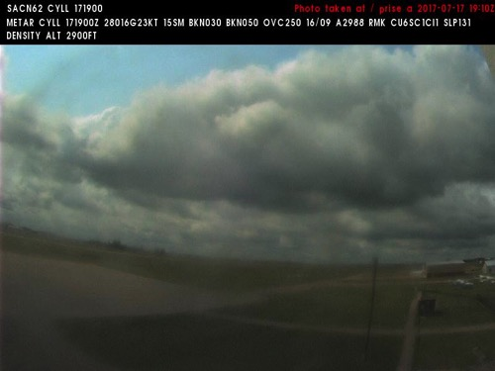
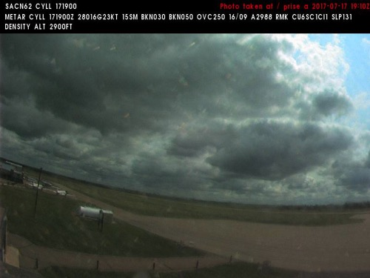
17 July 2017/DOY 198 BERMS – BOREAS Area
Lloydminster Airport (CYLL) N53 18 33 W110 04 21
NORTH
Northwest
Northeast
West
Southeast
Notes:
NAVCAM sky pictures from the Lloydminster Airport at 1910 UTC showing partly cloudy skies
See http://www.metcam.navcanada.ca/hb/index.jsp?lang=e for an interactive map of Canadian aviation cameras

Slide 10
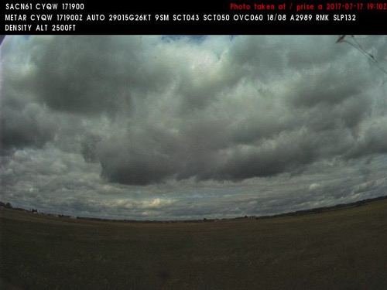
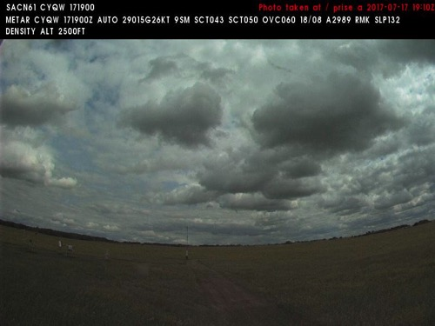
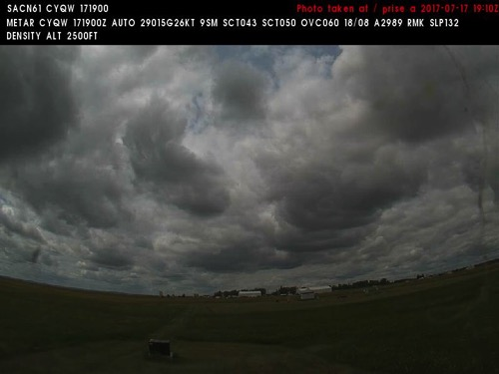
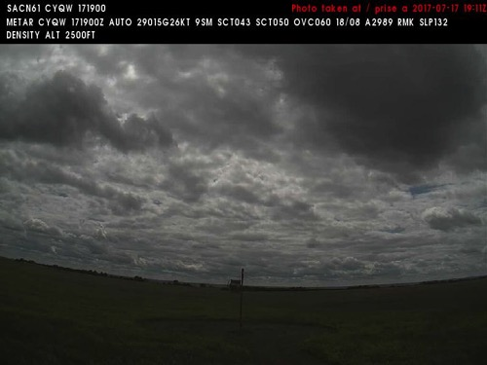
17 July 2017/DOY 198 BERMS – BOREAS Area
North Battleford (CYQW) N52 46 09 W108 14 37
NORTH
North
East
West
South
Notes:
NAVCAM sky pictures from the North Battleford Airport at 1910 UTC showing mostly cloudy skies
See http://www.metcam.navcanada.ca/hb/index.jsp?lang=e for an interactive map of Canadian aviation cameras

Slide 11
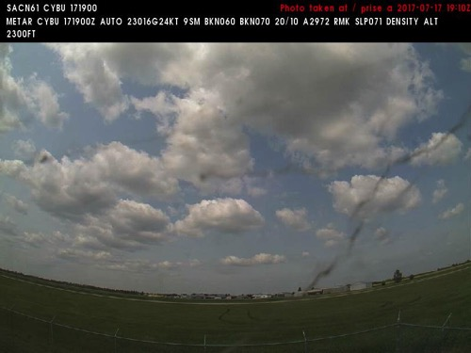
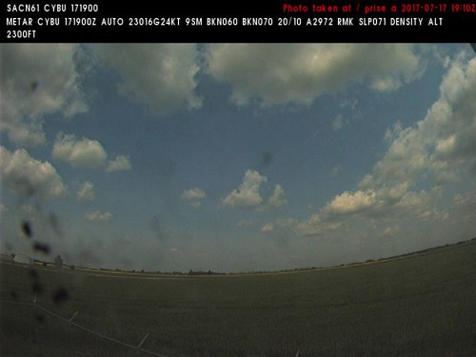
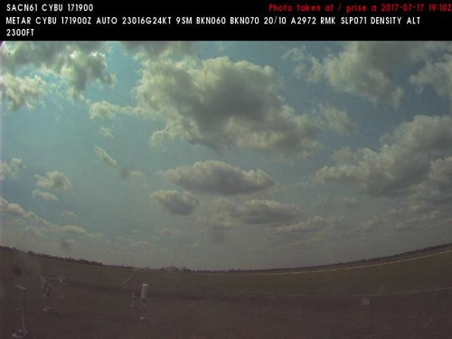
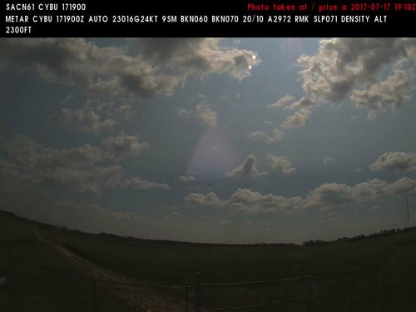
17 July 2017/DOY 198 BERMS – BOREAS Area
Nipawin (CYBU) N53 19 59 W104 00 14
NORTH
Northwest
North
West
Southeast
Notes:
NAVCAM sky pictures from the Nipawin Airport at 1910 UTC showing partly to mostly cloudy skies
See http://www.metcam.navcanada.ca/hb/index.jsp?lang=e for an interactive map of Canadian aviation cameras

Slide 12
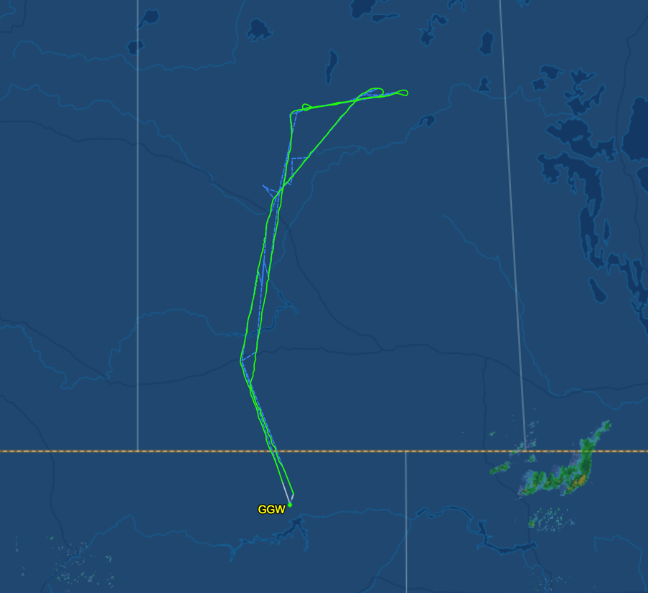
17 July 2017/DOY 198 BERMS – BOREAS Area
7/6/17 As-flown lines & acquisition segments
Data Acquisitions:
Line 131: Lloydminster (3x)
Line 128: BERMS flux towers
131
129

Slide 13
17 July 2017/DOY 198 BERMS – BOREAS Area
NORTH
Will update when Quick-look products are available

